Slide 1
Analysis of house prices
Investment Options
Gloria Mompremier

Slide 2
goal

Slide 3
What factors of a home significantly drive the home price?
Kitchen Quality
Building Type

Slide 4
hypotheses

Slide 5
Kitchen quality
Null Hypothesis 1: Homes with a "Good" quality kitchen perform the same as homes with "Bad" quality kitchens in mean sale prices
Alternative Hypothesis 1: There is a difference in the mean sale prices of homes that have a “Good” quality kitchen in comparison to a "Bad" quality kitchen

Slide 6
Building type
Null Hypothesis 2: Single Family homes perform the same in mean sales of home prices as all other home types
Alternative Hypothesis 2: There is a difference in the mean sales of home prices in Single-family homes compared to all other home types

Slide 7
Process

Slide 8
Review data on the quality of the kitchens and the building types of the homes
For the kitchen quality, filter the data by the rating of the kitchen quality into 2 fields. “Good” or “Bad”
Good – Excellent or Good
Bad – Typical/Average, Fair, Poor
For the building type, filter the data by the build of the home. “Single-family” homes or all “Other Types” of homes
Single-family
Other types – 2 family Conversion, Duplex, Townhouse End Unit, Townhouse Inside Unit
Conduct a statistical analysis to see if there is a statistically significant difference in the mean of home sales based on the kitchen quality or building type
Make recommendations based on analysis results

Slide 9
Analysis of kitchen quality

Slide 10
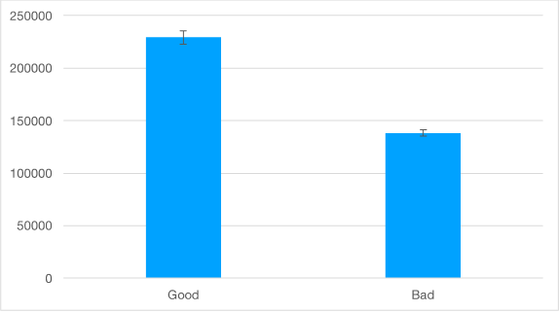
The Null Hypothesis is rejected
There is a difference between the mean of home sale prices of houses with a “Good” quality kitchen compared to houses with a “Bad quality kitchen
With 95% confidence, home sale prices of houses with a “Good” quality kitchen are much higher than that of homes with a “Bad” quality kitchen

Slide 11
Analysis of building type

Slide 12
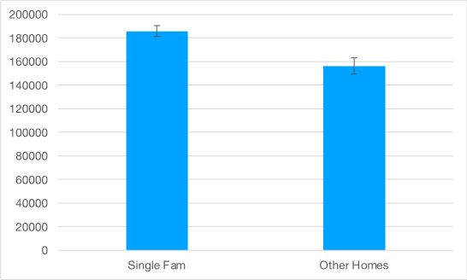
The Null Hypothesis is rejected
There is a difference between the mean of home sales of Single-family homes compared to Other home types
With a 95% confidence, the home sale prices of Single-family homes are higher than that of all Other home types

Slide 13
RECOMMENDATIONS

Slide 14
The dollars earmarked for investment into mortgage-backed securities can be allocated towards homes with “Good” quality kitchens and Single-family homes. These factors drive home prices
Homes with “Good” quality kitchens had mean sales of $92000 more than homes with “Bad” quality kitchens
Single-family homes had mean sales of $29000 more than Other home types
For reference:
The Excel workbook is here.

Slide 15
THANK YOU
Questions?

